Slide 1
Delivering Mobility as a Service MaaS Scotland
Dr George Hazel OBE
Programme Manager, MaaS Scotland
Challenges for Urban Mobility 2017
Barcelona, 13 November, 2017

Slide 2
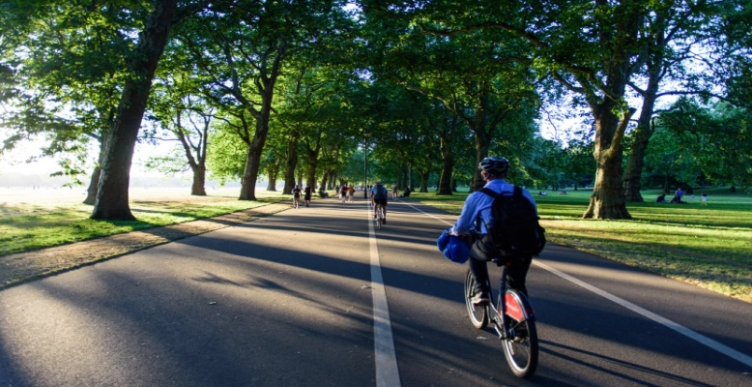
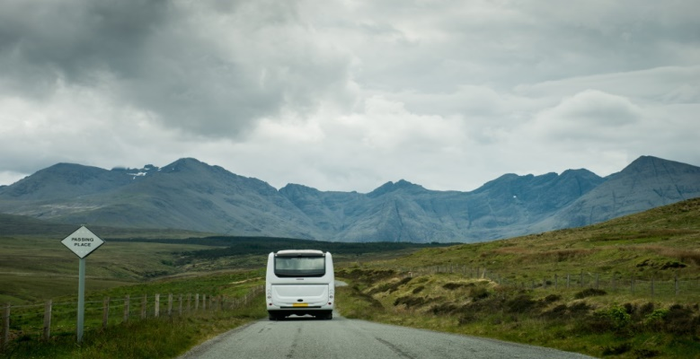
Where did MaaS come from?
Global market forces
Personalisation
Complexity of lifestyle
Smart technology
Mobile
IoT
Integrated mobility
ITS
Smart ticketing
TMS

Slide 3

The MaaS Value Chain
Information
Things
Vehicles
Network
Service
Provider
Things that move
Vehicles
People
Goods
Land
Sea
Air
Things
Networks
Information
Transport
ICT
Smart Grid
Big Data
Service Provider
Vehicles
Valued
Integrated
Trusted
Networks
Customers
People
Business
Government
Service
Buyer
Notes:
Prospective customer involvement

Slide 4
What are the key elements of MaaS?
User focused – lifestyle needs. A bottom-up system starting with the user – personal and business
Valued by the user
Door to door, reliable, seamless service as good as the private car
Mode neutral – all about seamless, reliable door to door journeys
One account/one Mobility Service Provider for the user
Can originate around public transport or the private car – incremental changes

Slide 5
Many questions to be answered!
How can the transport industry get involved with MaaS systems – can it lead?
What is the role of central and local government?
How can we change from an operational, top down, mode based business model to a customer focused, seamless, mode neutral service business model?
How can we ensure social equity and environmental sustainability?
Does MaaS work in rural areas and low income areas?
How do we integrate top down strategic city/regional planning with bottom up personalised MaaS systems?
….Lots of questions. Need to do it to answer them!
…So here’s what we are doing!

Slide 6
MaaS Scotland
We believe in rethinking mobility in a way that’s faster, smarter and greener than before.
By encouraging shared work and collaboration, we plan to drive Scotland’s MaaS Community to offer new and alternative ways to travel, address user needs and develop technological solutions.
Aim to generate a thriving ecosystem in Scotland, enabling a future of smart, efficient and sustainable mobility
With an appetite from industry, strong existing capability and support from Scotland’s leading technology trade associations, MaaS Scotland aims to secure Scotland’s future as one of the leading locations for the development of MaaS

Slide 7
Projects
Cairngorm National Park/Inverness Region – Urban/Rural National Park and tourism
MILL Project, Dundee City Council/Tay Cities Deal – City
Perth and Kinross Council with Stagecoach and Hiyacar – Small city/rural villages
Isle of Arran mobility package – ferry, rail, bus, taxi, bike and car – Rural island
Nevis Technologies – Regional areas
Stirling Regional Council – Small city/rural villages
Transport Scotland Smart Highway Corridor – Connected vehicle highway corridor/tourism/rural communities
Edinburgh Council/Transport For Edinburgh - City
Orkney Islands Council – Rural islands/mainland connections/major town/tourism
Navigogo – sectoral development with young people. Possible project for dementia sufferers and carers

Slide 8
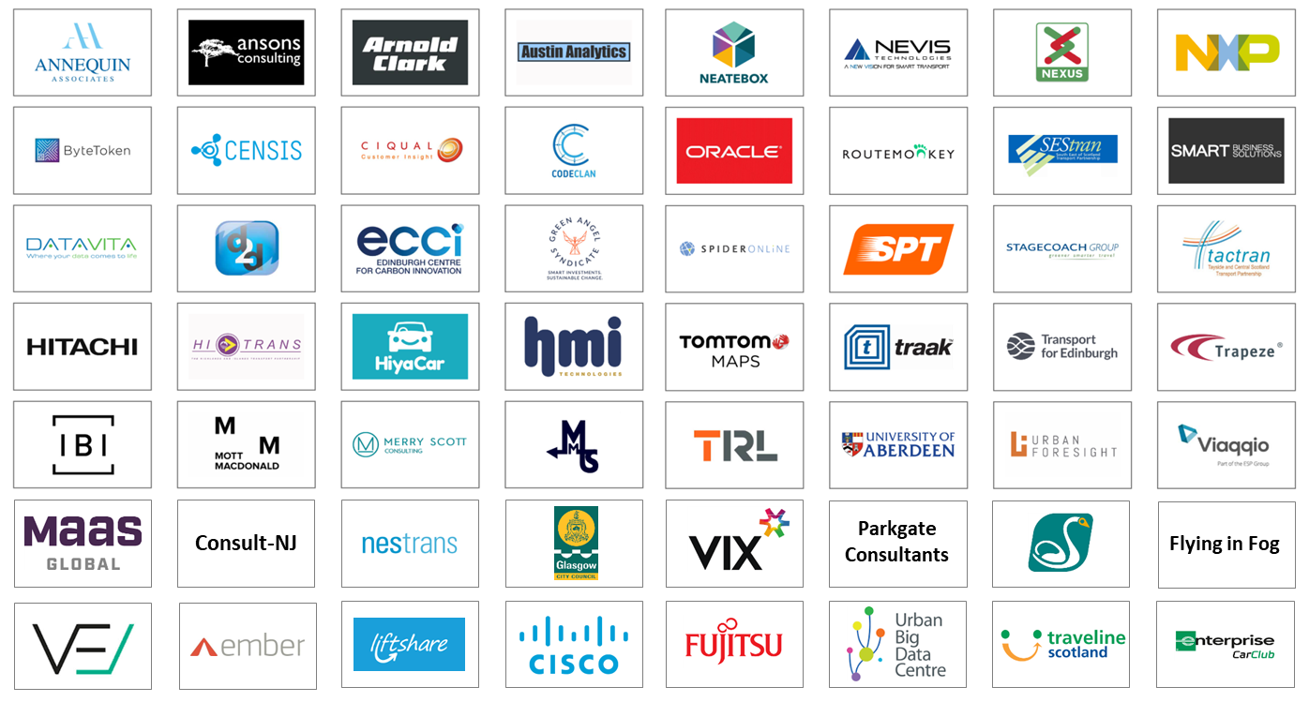
56 members to date

Slide 9
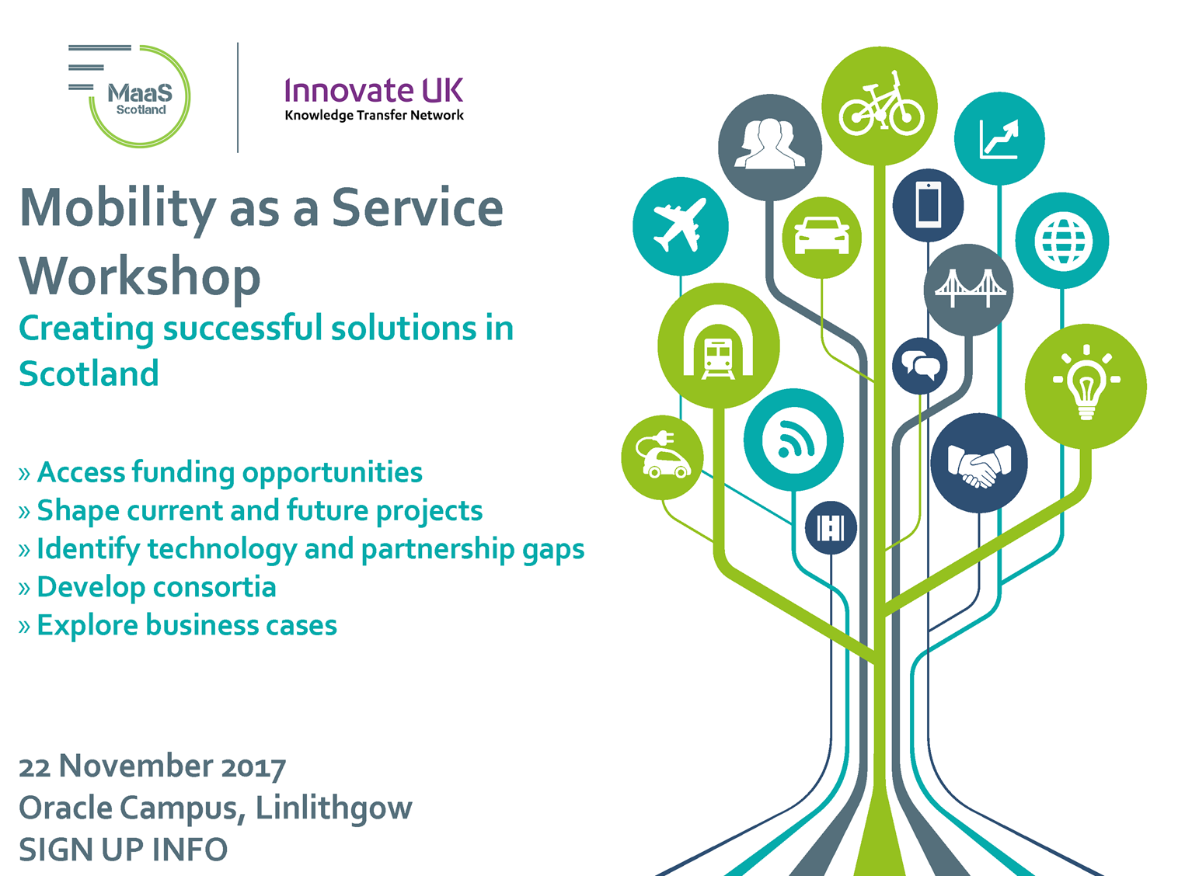

Slide 10
Delivering Mobility as a Service MaaS Scotland
Dr George Hazel OBE
Programme Manager, MaaS Scotland
Challenges for Urban Mobility 2017
Barcelona, 13 November, 2017

